Slide 1
Lesson 1: Essentials
1.1 The SAS Programming Process
1.2 Using SAS Programming Tools
1.3 Understanding SAS Syntax

Slide 2
Lesson 1: Essentials
1.1 The SAS Programming Process
1.2 Using SAS Programming Tools
1.3 Understanding SAS Syntax

Slide 3








SAS Programming Language
Notes:
It's impossible to understand data without using tools that help us derive meaning from numbers and text. SAS offers a huge collection of tools and solutions to handle your data needs, but at the core of it all is the SAS programming language. Regardless of the SAS suite of tools that you might have licensed, the Base SAS programming language is included. In this course, you learn how to write SAS code to handle the most common data processing tasks.

Slide 4
SAS Programming Process
Access data
Explore data
Prepare data
Analyze and report on data
Export results
Notes:
As you go through the process of making data meaningful and actionable, you'll likely follow these basic steps: access data or read it with a program, explore the data to see what's there and what you might need to add or change, prepare the data to get it ready for analysis, analyze and report on the data, and export results to various report and data formats. We'll use this process as the framework for teaching you the fundamentals of the SAS programming language.

Slide 5


SAS Programming Process
Access data
Explore data
Prepare data
Analyze and report on data
Export results
international storm data
Notes:
In this class, we'll mainly be analyzing international storm data – real data about storms such as hurricanes, typhoons, and cyclones that has been collected since 1980. This data is stored in a variety of formats, and the first thing you learn to do is write a SAS program to access the data.

Slide 6
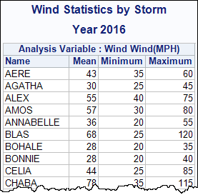

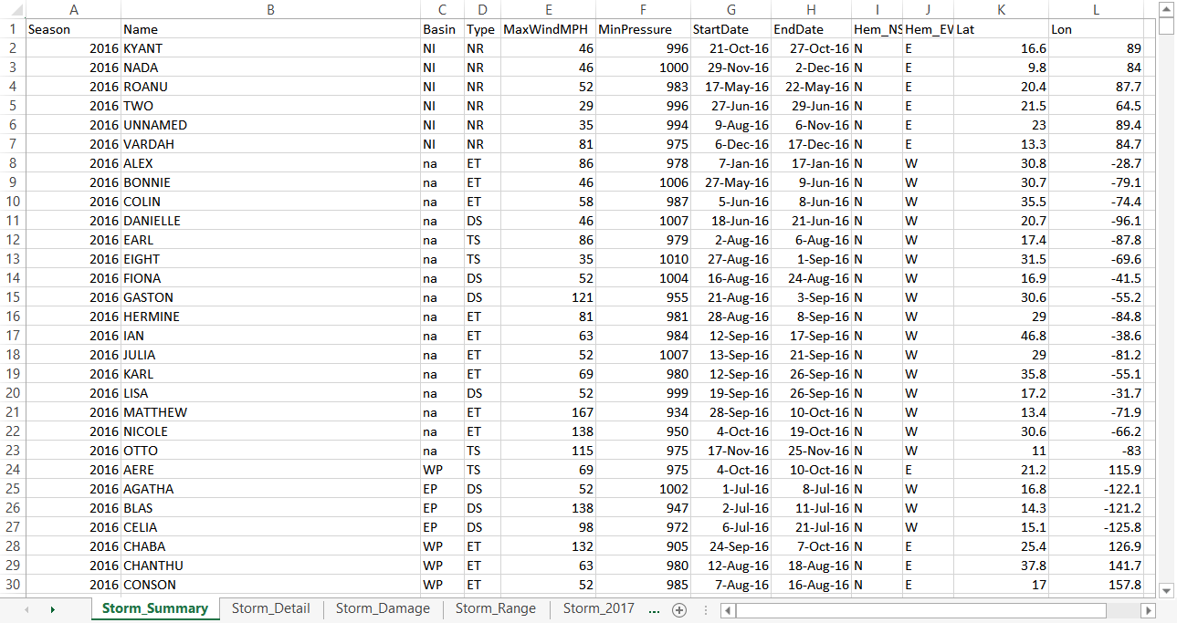
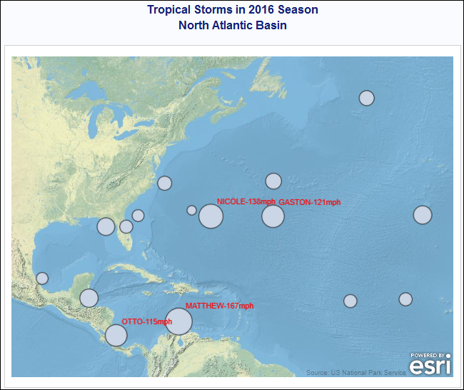
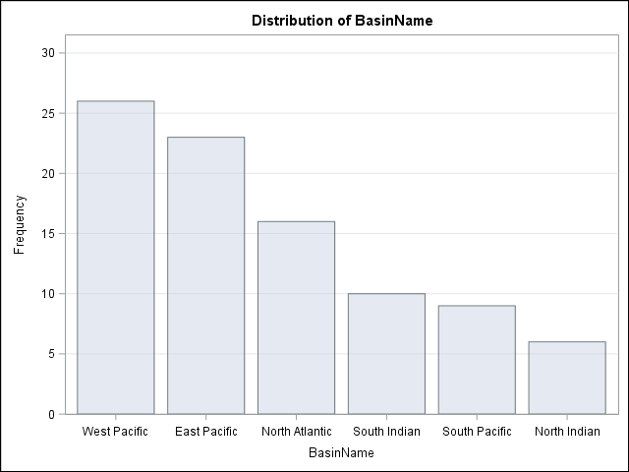
SAS Programming Process
Access data
Explore data
Prepare data
Analyze and report on data
Export results
Notes:
As you continue through the programming process, you learn to write SAS programs that turn this data into informative reports, data, and graphics.

Slide 7
SAS Programming Process
This demonstration examines the international storm data that is used in course demonstrations.
p101d01
Notes:
Let’s get right to the code and run a program that has each of these programming steps. By the end of the class, you will be able to write this type of code.

Slide 8
Discussion
Which steps of the programming process are most challenging or critical in your work?

Slide 9
Data Used in This Course
US National Park data
class
cars
international storm and weather data
shoes
Europe tourism and trade data
Notes:
In this course, we want you to be writing code as much as possible – because that's the best way to learn! Our main focus will be analyzing the storm data you just saw in the demo, but we will also use US national park and Europe tourism and trade data. We'll also use some sample data tables that are provided by SAS.

Slide 10
Practicing in This Course
Demonstration | Performed by your instructor as an example for you to observe
Activity | Short practice opportunities for you to perform in SAS, either independently or with the guidance of your instructor
Practice | Extended practice opportunities for you to work on independently
Case Study | A comprehensive practice opportunity at the end of the class
Notes:
As you go through the course, you have different opportunities to practice. You can watch the demos or you can follow along.

Slide 11
Choosing a Practice Level
Level 1 | Solve basic problems with step-by-step guidance
Level 2 | Solve intermediate problems with defined goals
Challenge | Solve complex problems independently with SAS Help and documentation resources
Choose one practice to do in class based on your interest and skill level.
Notes:
When you come to a practice, you can choose a level.

Slide 12
Lesson 1: Essentials
1.1 The SAS Programming Process
1.2 Using SAS Programming Tools
1.3 Understanding SAS Syntax

Slide 13
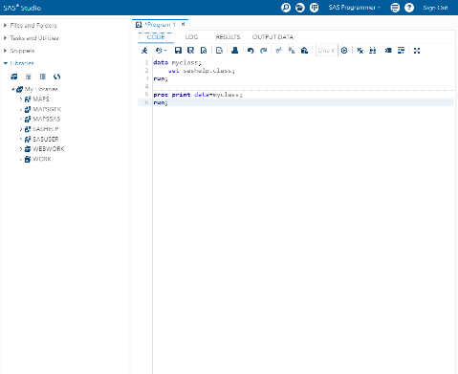
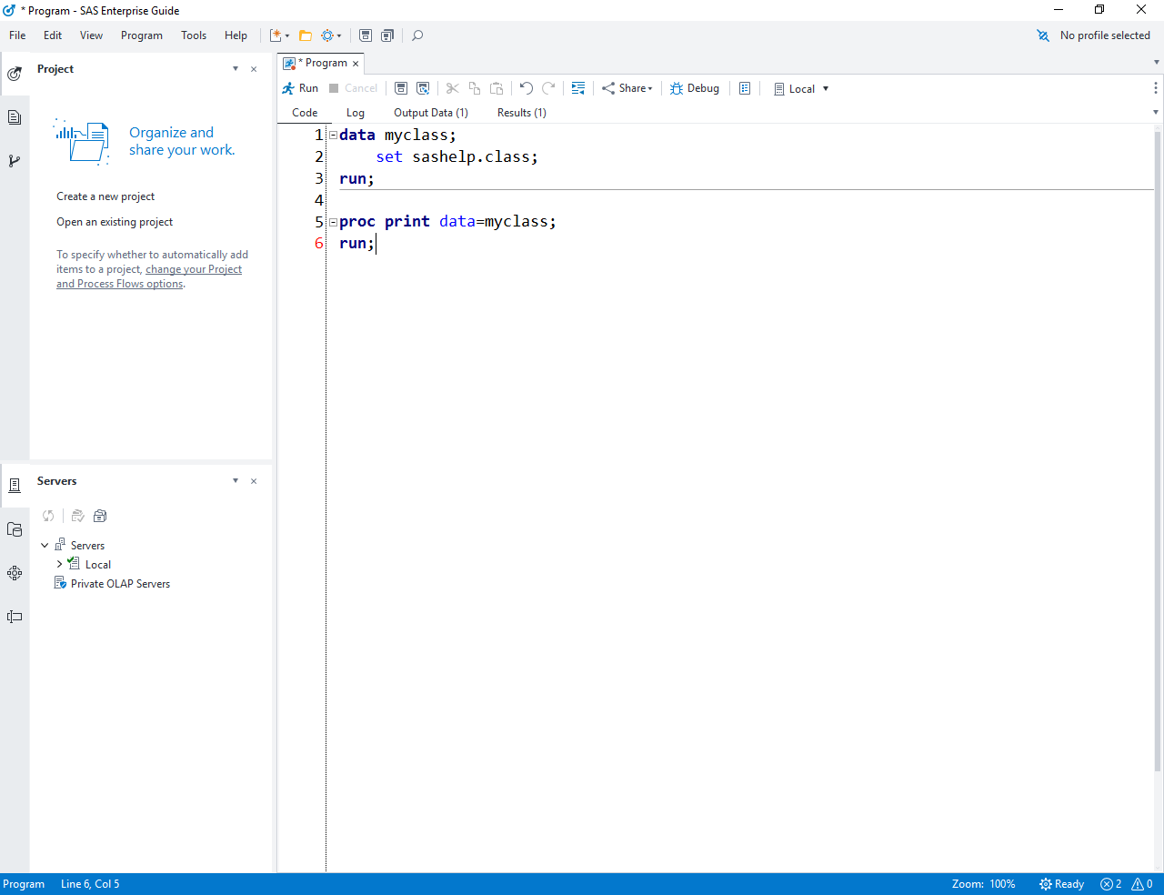
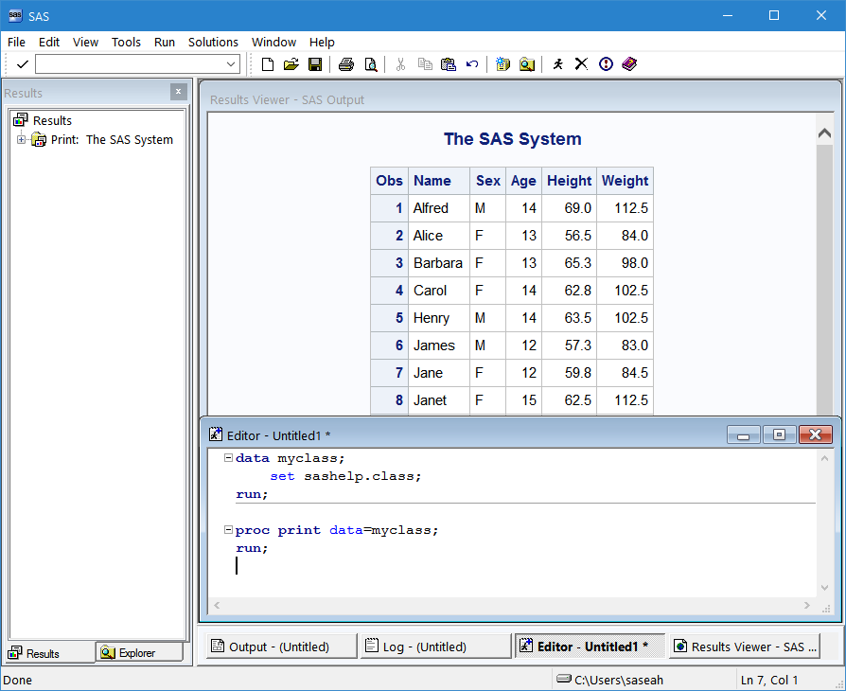
SAS Programming Interfaces
SAS Studio
SAS Enterprise
Guide
All these interfaces have the basic tools that you need for programming.
SAS windowing environment
Notes:
SAS has several programming interfaces that you can use to interactively write and submit code. These interfaces include the SAS windowing environment, the interface that is part of SAS; SAS Enterprise Guide, a client application that runs on your PC and accesses SAS on a local or remote server; and SAS Studio, a web-based interface to SAS that you can use on any computer.
In this class, we use SAS Studio and SAS Enterprise Guide because they include the most modern programming tools. In addition to SAS interfaces, it's also possible to write and submit code in applications such as Jupyter Notebook, but you won't have access to some of the programming tools that SAS offers.

Slide 14
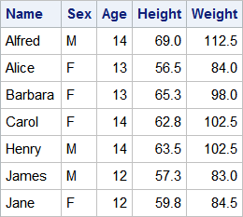
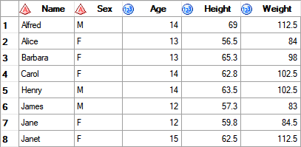
SAS Programming Interfaces
write and submit code
view messages from SAS
view results
1 data myclass;
2 set sashelp.class;
3 run;
NOTE: There were 19 observations read from
the data set SASHELP.CLASS.
NOTE: The data set WORK.MYCLASS has 19
observations and 5 variables.
NOTE: DATA statement used:
real time 0.01 seconds
cpu time 0.00 seconds
4
5 proc print data=myclass;
NOTE: Writing HTML Body file: sashtml.htm
6 run;
NOTE: There were 19 observations read
from the data set WORK.MYCLASS.
data myclass;
set sashelp.class;
run;
proc print data=myclass;
run;
Editor
Log
Results and Output Data
Notes:
To program, you need some basics: an editor to write and submit code, a way to read messages related to the code that you submit (this is called the log in SAS), and a way to view the reports and data that your programs create. Although they look different and are organized differently, all SAS interfaces have these programming tools. In addition, SAS Studio and Enterprise Guide have an editor that is smart about SAS code, with features such as code completion and syntax coloring. This makes programming much easier!
In this course, you can practice in your preferred interface, but we'll start by showing you how to write and submit code in both SAS Studio and SAS Enterprise Guide just in case you aren't sure which one you want to use.

Slide 15
Submitting a SAS Program in SAS Enterprise Guide and SAS Studio
These two demonstrations illustrate writing and submitting a simple SAS program and examining the log and results. The demos also show how to open and run an existing SAS program.

Slide 16
1.01 Multiple Answer Question
Which SAS interface will you use in class?
SAS Enterprise Guide
SAS Studio
Notes:
Type answer here

Slide 17
Practice
This practice reinforces the concepts discussed previously.

Slide 18
Accessing the Course Files
course files
activities
Make a note of the location of your course files folder.
data
demos
practices
output
Notes:
For this course, you use a variety of data files and SAS programs. The SAS program files are organized into folders for activities, demos, and practices.

Slide 19
Accessing the Course Files
Programs in the activities, demos, and practices folders follow this naming convention.
course files
activities
data
demos
practices
p104d01.sas
Programming 1, Lesson 4, demo 1
output
Notes:
These folders contain starter SAS programs for you to use. The file names follow this naming convention: the name starts with P1 for programming 1, followed by two digits for the lesson number. Then the letter A, D, or P indicates activity, demo, or practice, followed by a sequential two-digit number within the lesson. When you come to an activity, demo, or practice, the instructions indicate the file that you need to open. There is also a solutions folder in the practices folder that has complete solution programs.

Slide 20
Creating the Course Data
course files
activities
data
cre8data.sas
demos
practices
output
Notes:
In the next activity, you run a SAS program that creates the SAS data you need for your environment. Make note of the location of your course data because you'll need to use that path in the future.

Slide 21
1.02 Activity (Required)
SAS Studio: In the Navigation pane, expand Files and Folders and then navigate to the course files folder. SAS Enterprise Guide: In the Servers list, expand Servers ⇨ Local ⇨ Files, and then navigate to the course files folder.
Double-click the cre8data.sas file to open the program.
Find the %LET statement. As directed by your instructor, provide the path to your course files.
Run the program and verify that a report that lists 22 tables is created.
Notes:
Type answer here

Slide 22
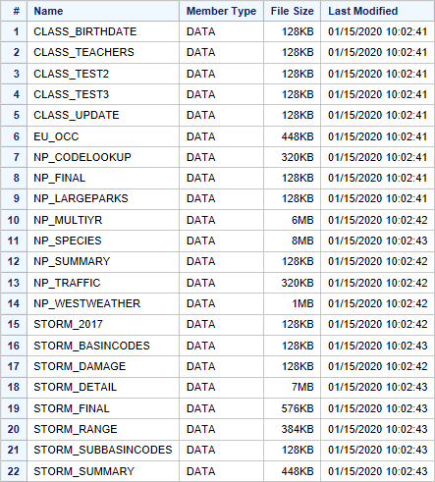
1.02 Activity – Correct Answer
Confirm that 22 SAS tables were created.
Notes:
Type answer here

Slide 23
Lesson 1: Essentials
1.1 The SAS Programming Process
1.2 Using SAS Programming Tools
1.3 Understanding SAS Syntax

Slide 24
SAS Program Structure
step
data myclass;
set sashelp.class;
heightcm=height*2.54;
run;
proc print data=myclass;
run;
proc means data=myclass;
var age heightcm;
run;
step
A SAS program consists of a sequence of steps.
step
. . .
SAS program
Notes:
A SAS program consists of a sequence of steps. Each step in the program performs a specific task.

Slide 25
SAS Program Structure
DATA step
data myclass;
set sashelp.class;
heightcm=height*2.54;
run;
proc print data=myclass;
run;
proc means data=myclass;
var age heightcm;
run;
A program can be any combination of DATA and PROC (procedure) steps
PROC step
Notes:
Two kinds of steps make up SAS programs: DATA steps and PROC steps. A SAS program can contain any combination of DATA steps and PROC steps depending on what tasks you need to perform.

Slide 26
SAS Program Structure
DATA step
data myclass;
set sashelp.class;
heightcm=height*2.54;
run;
proc print data=myclass;
run;
proc means data=myclass;
var age heightcm;
run;
DATA steps typically read, process, or create data.
Notes:
A DATA step usually reads data from an input source, processes it, and creates a SAS data set. A DATA step could include filtering rows, computing new columns, joining tables, or many other data manipulations. In this program, the DATA step is creating a copy of an existing SAS table and adding a new column to convert height from inches to centimeters.

Slide 27
SAS Program Structure
data myclass;
set sashelp.class;
heightcm=height*2.54;
run;
proc print data=myclass;
run;
proc means data=myclass;
var age heightcm;
run;
PROC steps typically report, manage, or analyze data.
PROC step
Notes:
A PROC, or procedure, step typically processes a SAS data set. SAS has dozens of procedures that generate reports and graphs, manage data, or perform complex statistical analysis. This program has two PROC steps: PROC PRINT generates a list of all the rows and columns in the data, and PROC MEANS calculates basic summary statistics for age and heightcm.

Slide 28
SAS Program Structure
Steps begin with either DATA or PROC.
data myclass;
set sashelp.class;
heightcm=height*2.54;
run;
proc print data=myclass;
run;
proc means data=myclass;
var age heightcm;
run;
This program has three steps.
Steps end with RUN. Some PROCs end with QUIT.
Notes:
Steps always begin with either the keyword DATA or PROC. Most steps end with a RUN statement, but a few procedures end with a QUIT statement. If you don’t use a RUN statement at the end of a step, the beginning of a new DATA or PROC step will also signal the end of the previous step.

Slide 29
SAS Program Structure
step
data myclass;
set sashelp.class;
heightcm=height*2.54;
run;
proc print data=myclass;
run;
proc means data=myclass;
var age heightcm;
run;
statement;
statement;
statement;
A step is a sequence of SAS statements.
step
step
SAS program
Notes:
DATA and PROC steps in a program consist of a sequence of statements. I like to think of steps as the paragraphs in a program, and statements as the sentences within the paragraphs.

Slide 30
SAS Statement Syntax
data myclass;
set sashelp.class;
heightcm=height*2.54;
run;
proc print data=myclass;
run;
proc means data=myclass;
var age heightcm;
run;
Most statements begin with a keyword, and all statements end with a semicolon.
Notes:
Most statements begin with an identifying keyword. In addition to DATA, PROC, and RUN statements, this program also includes SET and VAR statements. The one statement that doesn’t begin with a keyword is the one that is creating the new column heightcm. But the really important thing to remember here is that all statements end with a semicolon.

Slide 31
Global Statements
TITLE . . . ;
OPTIONS . . . ;
Global statements are typically outside of steps and do not need a RUN statement.
LIBNAME . . . ;
Notes:
In addition to DATA and PROC steps, a SAS program can also contain global statements. These statements can be outside DATA and PROC steps, and they typically define some option or setting for the SAS session. Global statements do not need a RUN statement after them.

Slide 32
1.03 Activity
Open p101a03.sas from the activities folder and perform the following tasks:
View the code. How many steps are in the program?
How many statements are in the PROC PRINT step?
How many global statements are in the program?
Run the program and view the log.
How many observations were read by the PROC PRINT step?
Notes:
Type answer here

Slide 33
1.03 Activity – Correct Answer
Open p101a03.sas from the activities folder and perform the following tasks:
View the code. How many steps are in the program? There are three steps: one DATA step and two PROC steps.
How many statements are in the PROC PRINT step? four statements
How many global statements are in the program? three TITLE statements
Run the program and view the log.
How many observations were read by the PROC PRINT step? 11 observations
Notes:
Type answer here

Slide 34
SAS Program Syntax: Format
data myclass;set sashelp.class;run;
proc print data=myclass;run;
These are the same to SAS.
data myclass;
set sashelp.class;
run;
proc print data=myclass;
run;
Formatting makes your code easier to read and understand.
Notes:
Now let's talk about some syntax details.
These two programs have exactly the same code. Spacing doesn’t matter to SAS, but it does matter to people reading your code. You can use spaces and extra lines to make your program easy to read and understand. There are also tools in your editor that format code for you!

Slide 35
SAS Program Syntax: Case
data under13;
set sashelp.class;
where AGE<13;
drop heIGht Weight;
run;
Unquoted values can be in any case.
Notes:
You can use any case for unquoted values, such as column or table names.

Slide 36
SAS Program Syntax: Comments
comments out everything between /* and */
/* students under 13 yo */
data under13;
set sashelp.class;
where Age<13;
*drop Height Weight;
run;
Comments are ignored when a program executes.
comments out a single statement ending in a semicolon
Notes:
Another thing you can do to make your code more understandable is to add comments. Any commented text is ignored when the program executes. Comments are also useful when you're testing code because you can suppress a portion of the code from execution. You can comment out a single line of code by adding an asterisk in from of that line. You can comment out multiple lines of code by adding /* at the beginning and */ at the end.

Slide 37
Understanding SAS Program Syntax
This demonstration illustrates examining program statements, improving program spacing, and adding comments.
p101d02
Notes:
Let’s look at this program, which is the same program we just looked at, but obviously the spacing is much different. This program is syntactically correct based on the rules for SAS statements. How many statements are in the PROC MEANS step? The easy way to figure it is to just count semicolons between PROC MEANS and RUN – so 4 statements.
Although this program isn’t pretty because of the inconsistent spacing, it does run with no syntax errors. It is a best practice to establish a set of formatting standards so that your programs are easier to read. If you are using Enterprise Guide or SAS Studio, you can ask the application to format the program for you. In Enterprise Guide, simply select Edit -> Format Code or press CTRL+I. In SAS Studio, click the Format Code button.
I will add a comment to describe the purpose of the program, and use the /* comment */ syntax. A convenient shortcut that works in all three interfaces is to type the comment, highlight it, then press CTRL+L. This also works if you want to comment a section of code. After adding the comment symbols, you can uncomment the block by pressing CTRL+SHIFT+/ in the windowing environment or Enterprise Guide, or just CTRL+L in SAS Studio.
Let’s use the other commenting method to suppress the execution of the WHERE statement in PROC PRINT. If I run just that step, I see SAS prints all cars, not just those with AvgMPG greater than 35.

Slide 38
Finding and Resolving Syntax Errors
misspelled keywords
syntax errors
Warning or Error message
unmatched quotation marks
missing semicolon
invalid options
log
Notes:
Syntax errors are a fact of programming life. As a programmer, it's incredibly valuable to be able to identify, diagnose, and fix syntax errors in your code. A syntax error is an error in the spelling or grammar of a SAS statement. Examples of syntax errors include misspelled keywords, unmatched quotation marks, missing semicolons, and invalid options. You can catch some syntax errors, such as an unmatched quotation mark, by paying attention to the color-coded syntax. When SAS finds a syntax error in your submitted program, a warning or error message is written in the log.

Slide 39
Finding and Resolving Syntax Errors
This demonstration illustrates finding and resolving common syntax errors.
p101d03
Notes:
Let’s look at this program that includes three syntax errors. The first is misspelled DATA and DAAT. The color-coding in the editor helps to recognize that there is an issue with this keyword. Notice all the other keywords are bold blue font. The second error is a missing semicolon after the PROC PRINT statement. And the third error is an invalid option – average should instead be MEAN. Notice that the valid options on the PROC MEANS statement are blue. So we’ll assume we didn’t recognize these syntax options, and go ahead and run then program.
Let’s look carefully at the log. DAAT is underlined, and SAS provides a warning, indicating that is assumed we really meant to type DATA. The DATA step then runs successfully despite our error. The next error underlines VAR. There is nothing wrong with the VAR statement, but the error is generated because of the problem in the preceding statement – the missing semicolon. And if we read SAS’s error message carefully, the first suggested item in the list is a semicolon. Finally, AVERAGE is underlined, and the error message provides a detailed list of the valid options for the PROC MEANS statement. Included is the MEAN option.
Let’s go back to the program tab, fix our three syntax errors, and rerun the program. Even though our program generated output, it is still strongly recommended that you always carefully examine the log. Everything looks good now!

Slide 40
1.04 Activity
Open p101a04.sas from the activities folder and perform the following tasks:
Format the program to improve the spacing. What syntax error is detected? Fix the error and run the program.
Read the log and identify any additional syntax errors or warnings. Correct the program and format the code again.
Add a comment to describe the changes that you made to the program.
Run the program and examine the log and results. How many rows are in the canadashoes data?
data canadashoes; set sashelp.shoes;
where region="Canada;
Profit=Sales-Returns;run;
prc print data=canadashoes;run;
Notes:
Type answer here

Slide 41
1.04 Activity – Correct Answer
How many rows are in the canadashoes data? 37
/* Unbalanced quotation mark and
misspelled PROC fixed.*/
data canadashoes;
set sashelp.shoes;
where region="Canada";
Profit=Sales-Returns;
run;
proc print data=canadashoes;
run;
Formatting the code identifies the missing quotation mark.
Notes:
Type answer here

Slide 42
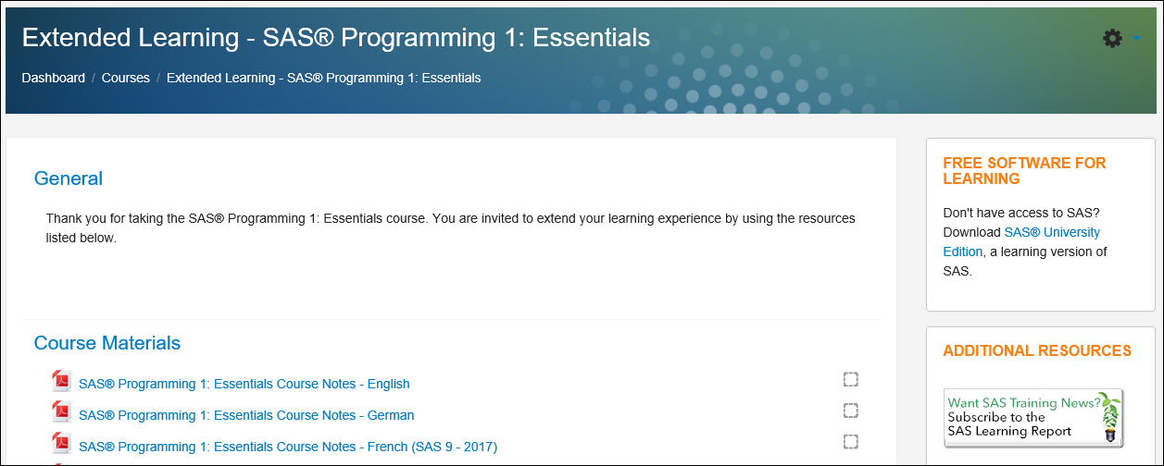
Extending Your Learning
Notes:
We hope you have already accessed your Extended Learning page and seen the many great resources available there. Not only can you download the course notes and data, but you can also take advantage of many other videos, papers, and links to supplemental information.

Slide 43
Beyond SAS Programming 1
What if you want to ...
. . . use point-and-click SAS Studio tasks to generate code?
. . . use the SAS windowing environment in this class?
. . . learn about using Enterprise Guide tasks to generate code?
Watch the video Getting Started with SAS Studio.
View additional free video tutorials on using SAS Studio tasks.
Watch the video Writing and Submitting SAS Code: Choosing an Editor.
Complete the SAS windowing environment activity on the Extended Learning Page.
Visit the Learn SAS Enterprise Guide page for videos, tutorials, and training.
Take the SAS Enterprise Guide 1: Querying and Reporting course.

Slide 44
Beyond SAS Programming 1
What if you want to ...
. . . use Jupyter Notebook to submit code to SAS?
. . . write code to take advantage of cloud-enabled SAS Viya?
. . . integrate open source languages with SAS?
Read the blog post How to run SAS programs in Jupyter Notebook.
Read the instructions and download Jupyter kernel for SAS on the SAS github page.
Watch the video An Introduction to SAS Viya Programming for SAS 9 Programmers.
Take the Programming for SAS Viya course after SAS Programming 1.
Take the free SAS Programming for R Users course.
Read the Getting Started with SAS Viya for R documentation.

Slide 45
Lesson Quiz

Slide 46
How many steps does this program contain?
one
two
four
eight
data national;
set sashelp.baseball;
BatAvg=nHits/nAtBat;
run;
proc contents data=national;
run;
proc print data=national;
run;
proc means data=national;
var BatAvg;
run;
Notes:
Correct answer: c
RUN, QUIT, DATA, and PROC statements function as step boundaries, which determine when SAS statements take effect and indicate the end of the current step or the beginning of a new step.

Slide 47
How many steps does this program contain?
one
two
four
eight
data national;
set sashelp.baseball;
BatAvg=nHits/nAtBat;
run;
proc contents data=national;
run;
proc print data=national;
run;
proc means data=national;
var BatAvg;
run;
Notes:
Correct answer: c
RUN, QUIT, DATA, and PROC statements function as step boundaries, which determine when SAS statements take effect and indicate the end of the current step or the beginning of a new step.

Slide 48
Running a SAS program can create which of the following?
log
output data
results
all of the above
Notes:
Correct answer: d
A SAS program will always create a log. A program can create output data and results as well, depending on steps included.

Slide 49
Running a SAS program can create which of the following?
log
output data
results
all of the above
Notes:
Correct answer: d
A SAS program will always create a log. A program can create output data and results as well, depending on steps included.

Slide 50
Which of the following is a SAS syntax requirement?
Begin each statement in column one.
Put only one statement on each line.
Separate each step with a line space.
End each statement with a semicolon.
Notes:
Correct answer: d
All SAS statements must end with a semicolon, but they are free-format. You can begin or end them anywhere, separate steps with line spaces, and optionally end steps with a RUN statement.

Slide 51
Which of the following is a SAS syntax requirement?
Begin each statement in column one.
Put only one statement on each line.
Separate each step with a line space.
End each statement with a semicolon.
Notes:
Correct answer: d
All SAS statements must end with a semicolon, but they are free-format. You can begin or end them anywhere, separate steps with line spaces, and optionally end steps with a RUN statement.

Slide 52
How many statements does this program contain?
five
six
seven
eight
*Create a cars report;
title "European Cars Priced Over 30K";
footnote "Internal Use Only";
proc print data=sashelp.cars;
where Origin='Europe'
and MSRP>30000;
var Make Model Type
Mpg_City Mpg_Highway;
run;
Notes:
Correct answer: c
This program contains seven statements (seven semi-colons): 1. comment, 2. TITLE, 3. FOOTNOTE, 4. PROC, 5. WHERE (two lines), 6. VAR (two lines), and 7. RUN.

Slide 53
How many statements does this program contain?
five
six
seven
eight
*Create a cars report;
title "European Cars Priced Over 30K";
footnote "Internal Use Only";
proc print data=sashelp.cars;
where Origin='Europe'
and MSRP>30000;
var Make Model Type
Mpg_City Mpg_Highway;
run;
Notes:
Correct answer: c
This program contains seven statements (seven semi-colons): 1. comment, 2. TITLE, 3. FOOTNOTE, 4. PROC, 5. WHERE (two lines), 6. VAR (two lines), and 7. RUN.

Slide 54
Which of the following steps is typically used to generate reports and graphs?
DATA
PROC
REPORT
RUN
Notes:
Correct answer: b
PROC steps are typically used to process SAS data sets (that is, generate reports, graphs, and statistics).

Slide 55
Which of the following steps is typically used to generate reports and graphs?
DATA
PROC
REPORT
RUN
Notes:
Correct answer: b
PROC steps are typically used to process SAS data sets (that is, generate reports, graphs, and statistics).

Slide 56
Does this comment contain syntax errors?
No. The comment is correctly specified.
Yes. Every comment line must end with a semicolon.
Yes. The comment is on more than one line.
Yes. There is a semicolon in the middle of the comment.
/*
Report created for budget
presentation; revised October 15.
*/
proc print data=work.newloan;
run;
Notes:
Correct answer: a
A block comment can contain semicolons and unbalanced quotation marks, can appear anywhere, and doesn’t need a semicolon at the end.

Slide 57
Does this comment contain syntax errors?
No. The comment is correctly specified.
Yes. Every comment line must end with a semicolon.
Yes. The comment is on more than one line.
Yes. There is a semicolon in the middle of the comment.
/*
Report created for budget
presentation; revised October 15.
*/
proc print data=work.newloan;
run;
Notes:
Correct answer: a
A block comment can contain semicolons and unbalanced quotation marks, can appear anywhere, and doesn’t need a semicolon at the end.

Slide 58
What result would you expect from submitting this step?
a report of the work.newsalesemps data set
an error message in the log
the creation of a table named work.newsalesemps
proc print data=work.newsalesemps
run;
Notes:
Correct answer: b
There is a missing semicolon following the data set name. When this step runs, SAS will interpret the word run as an option in the PROC PRINT statement (because of the missing semicolon). As a result, the PROC PRINT step will not execute and an error message will be displayed in the log.

Slide 59
What result would you expect from submitting this step?
a report of the work.newsalesemps data set
an error message in the log
the creation of a table named work.newsalesemps
proc print data=work.newsalesemps
run;
Notes:
Correct answer: b
There is a missing semicolon following the data set name. When this step runs, SAS will interpret the word run as an option in the PROC PRINT statement (because of the missing semicolon). As a result, the PROC PRINT step will not execute and an error message will be displayed in the log.

Slide 60
What happens if you submit the following program?
SAS does not execute the step.
SAS assumes that PROC is misspelled and executes the step.
porc print data=work.newsalesemps;
run;
Notes:
Correct answer: b
The log will indicate that SAS assumed that the keyword PROC was misspelled, corrected it temporarily, and executed the PROC step.

Slide 61
What happens if you submit the following program?
SAS does not execute the step.
SAS assumes that PROC is misspelled and executes the step.
porc print data=work.newsalesemps;
run;
Notes:
Correct answer: b
The log will indicate that SAS assumed that the keyword PROC was misspelled, corrected it temporarily, and executed the PROC step.

Slide 62
This program contains a syntax error because National is in different cases.
True
False
data national;
set sashelp.baseball;
BatAvg=nHits/nAtBat;
run;
proc means data=NATIONAL;
var BatAvg;
run;
Notes:
Correct answer: b
Case does not matter in unquoted values, so in this case, the data set name can be in specified in any case.

Slide 63
This program contains a syntax error because National is in different cases.
True
False
data national;
set sashelp.baseball;
BatAvg=nHits/nAtBat;
run;
proc means data=NATIONAL;
var BatAvg;
run;
Notes:
Correct answer: b
Case does not matter in unquoted values, so in this case, the data set name can be in specified in any case.

Slide 64
Which of the following is not a SAS programming interface?
SAS Enterprise Guide
SAS Manager
SAS Studio
SAS windowing environment
Notes:
Correct answer: b
The programming interfaces include SAS Enterprise Guide (client application), SAS Studio (web-based), and SAS windowing environment. There is not an interface/product called SAS Manager.

Slide 65
Which of the following is not a SAS programming interface?
SAS Enterprise Guide
SAS Manager
SAS Studio
SAS windowing environment
Notes:
Correct answer: b
The programming interfaces include SAS Enterprise Guide (client application), SAS Studio (web-based), and SAS windowing environment. There is not an interface/product called SAS Manager.

